Slide 1


Intro To Software Testing

Slide 2


Agenda
What is testing and software testing
Why Testing is Important
What is Bug and How to find Bugs
Type of Errors in SW
Testing Specification
Types of SW Testing in SW Engineering
Testing Levels
Testing Methodology
SDLC and STLC
V model

Slide 3

What is Software Testing
Software Testing is a method to check whether the actual software product matches expected requirements and to ensure that software product
is Defect free

Slide 4
Why Testing is Important?
To find and correct defects.
To Check whether the user’s needs are satisfied.
To avoid user detecting problems.
Also, to provide quality products.

Slide 5
Objectives
Ensure requirement matching with customer needed.
Define defects.
Prevent defects.
Ensure best quality.
Generate High quality test cases.

Slide 6
Why does SW have Bugs?
Miscommunication or No Communication.
That we are not clear about what an application should do or shouldn’t de.
Time Pressure.
Programming Mistakes.
Changing Requirements.

Slide 7
SW Testing Misunderstanding
Testing is debugging.
If programmers were more carful, testing would be unnecessary.
Testing activities start only after the coding is complete.
Testing never ends.
Testing is not a creative task.
Manual testing only.

Slide 8

What is Bug and How to find Bugs
A Bug is the deviation of the actual result from the expected result

Slide 9
Type of Errors in SW
A person makes an Error That creates a fault in software That can cause a failure in operation
Error:
An error is a human action that produces the incorrect result that results in a fault.
Bug:
The presence of error at the time of execution of the software.
Fault:
State of software caused by an error.
Failure:
Deviation of the software from its expected result. It is an event.

Slide 10








Type of Errors in SW
For any integer n, square (n) = n*n
Square(2) = 4
Correct result
Int square(int x)
{
return x*2;
}
Fault/Bug
Square(3) = 6
Failure

Slide 11
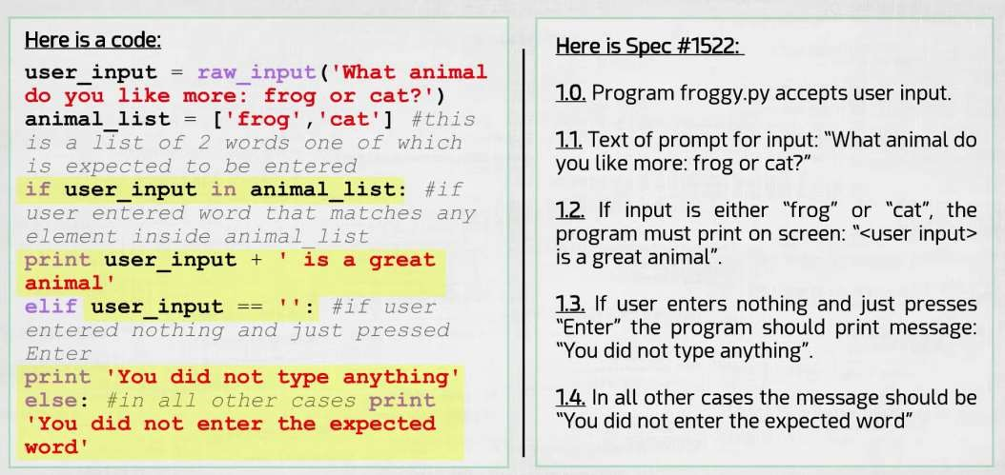
Testing Specification

Slide 12
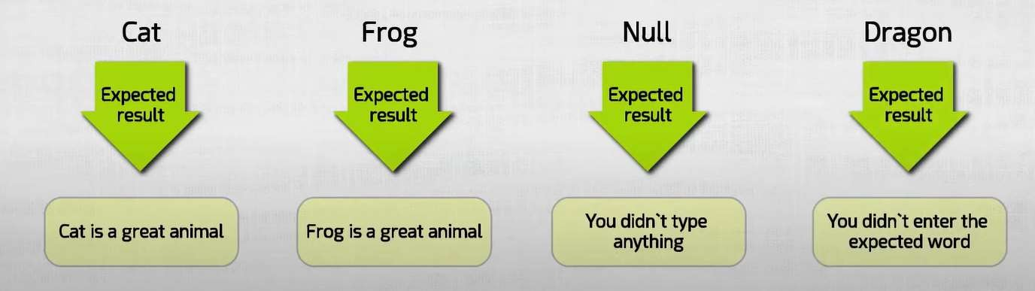
Test Cases

Slide 13
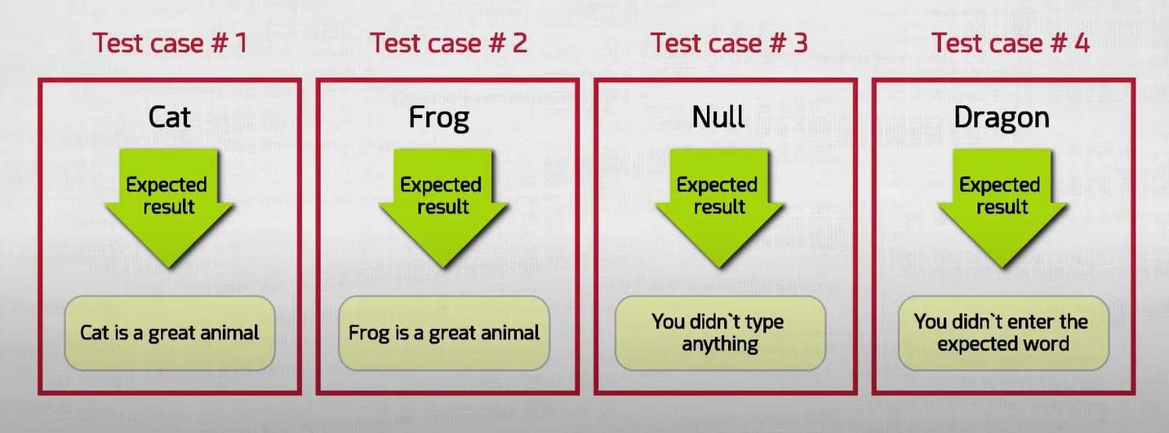
Test Cases No.

Slide 14

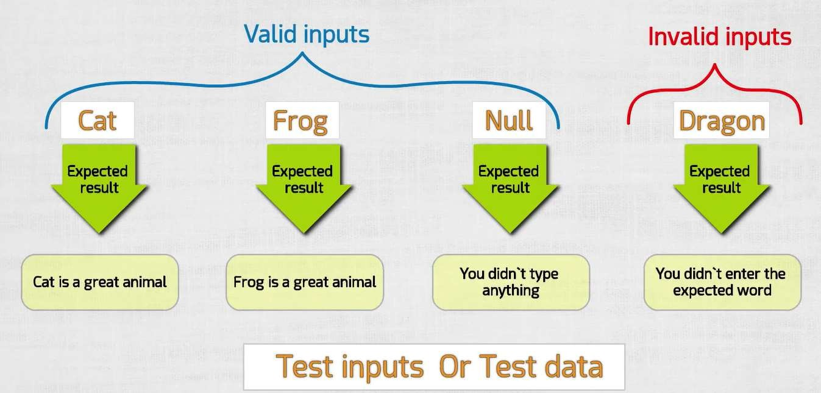

Slide 15
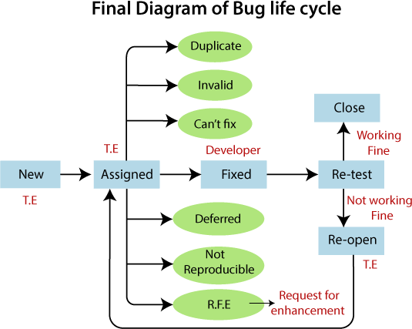
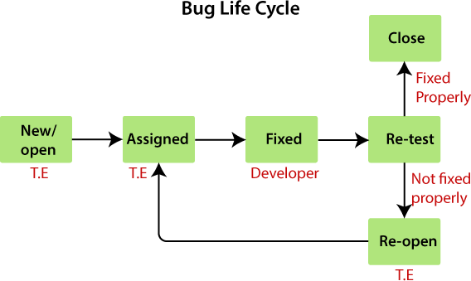
Bug Life Cycle

Slide 16
Software Free Error
Tester must make sure that 100% of the software work fine and error free
Whether we like it or not, there is always a probability that bugs will be missed by testers.
Testing cannot cover 100% of the possibilities of how software can operate.

Slide 17
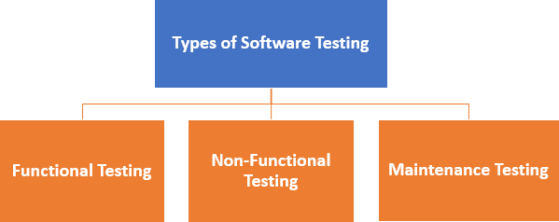
Types of SW Testing

Slide 18

Types of SW Testing in SW Engineering
Functional Testing
Unit Testing
Integration Testing
UAT (user accepted testing)
Non-Functional Testing
Performance
Usability
Scalability
Maintenance
Regression
Maintenance

Slide 19
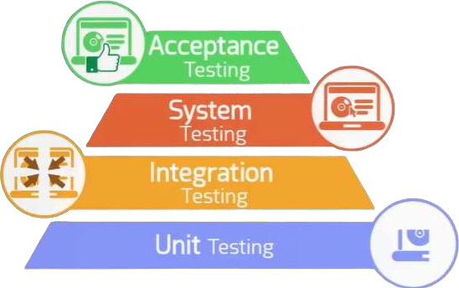
Level of Testing

Slide 20
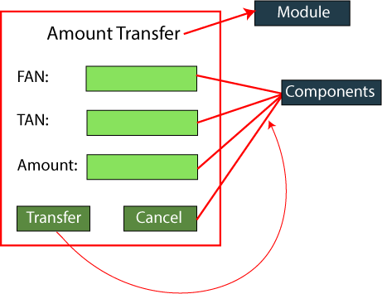
Unit testing example

Slide 21
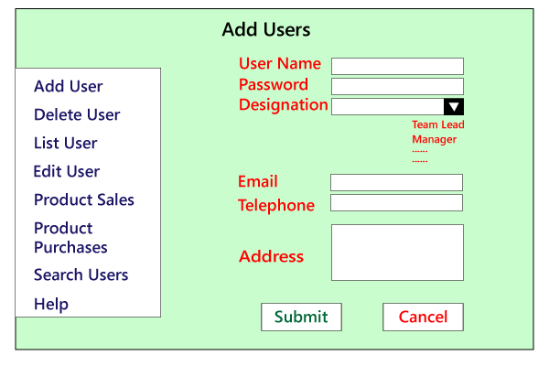
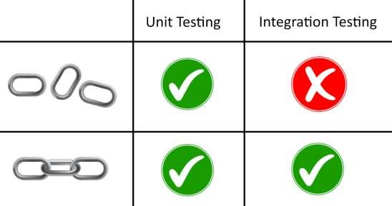
Integration testing example

Slide 22
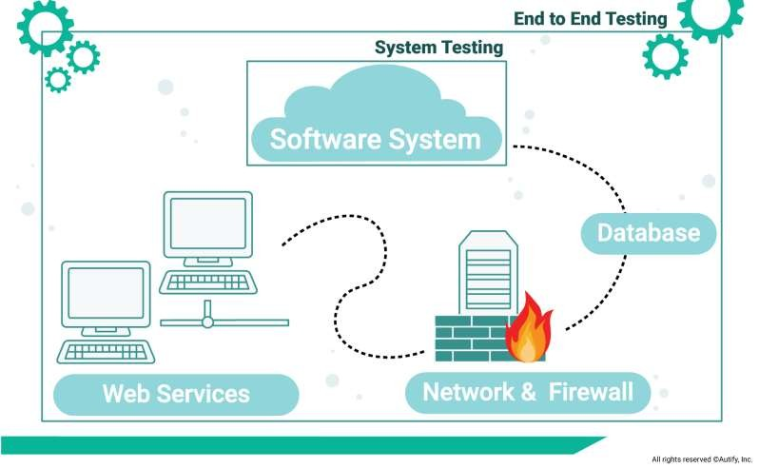
System Testing

Slide 23
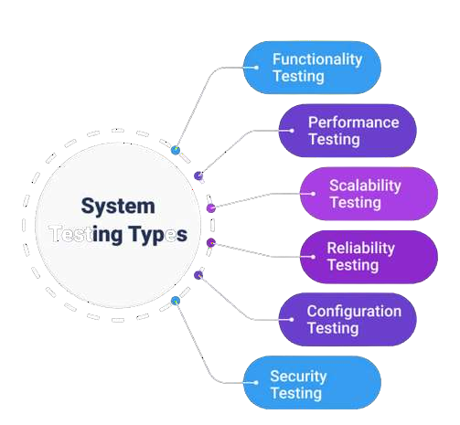
System Testing types

Slide 24
Testing Methodology
Black box testing
No knowledge of internal program design required.
Tests are based on requirements and functionality. or code
White box testing
Knowledge of the internal program design and code required.
Tests are based on coverage of code statements, branches, paths, conditions.

Slide 25
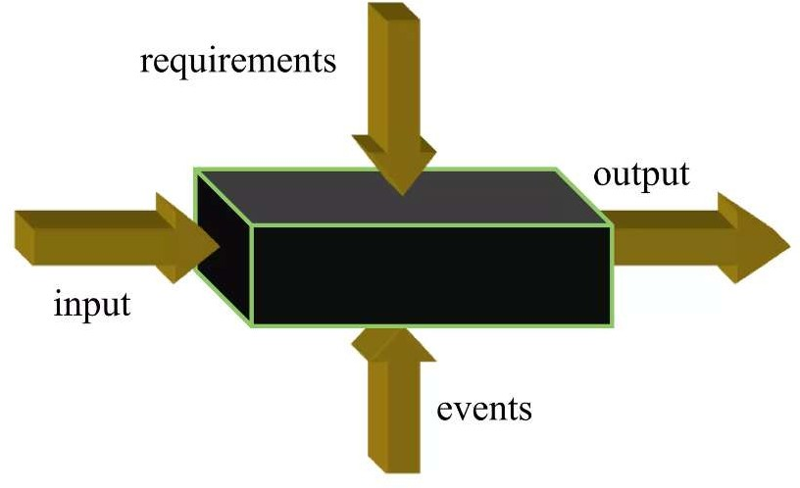
Black box testing
Applied for functional and non-functional testing, without reference to the internal structure of the system

Slide 26
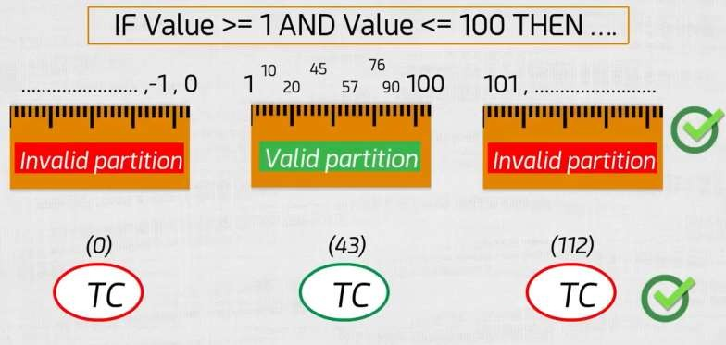
Black box testing techniques
Equivalence Partitioning (EP)
EX: range of data -> if VALUE is between 1 and 100 then print ‘Pass’

Slide 27
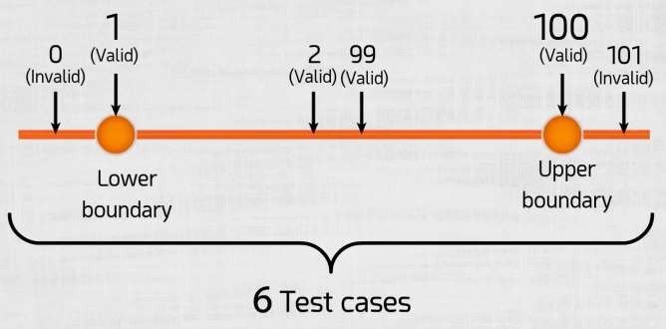
Black box testing techniques
Boundary value analysis(BVA)
EX: range of data -> if VALUE is between 1 and 100(inclusive). then print ‘Pass’
Find the boundary.
Lower boundary.
Upper boundary.
Test one value above and below it.
Applicable for numeric fields and date.

Slide 28
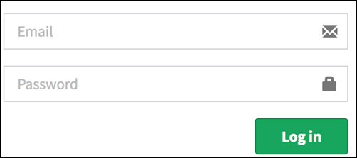
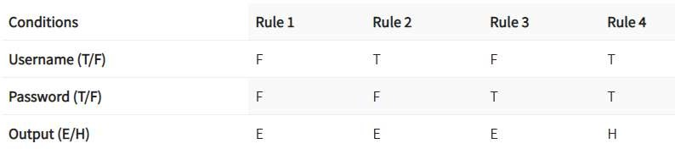
Black box testing techniques
Decision Table Testing
Used to test system behavior for different input combinations.
Decision Table is a tabular representation of inputs versus rules/cases/test conditions.
Ex:

Slide 29
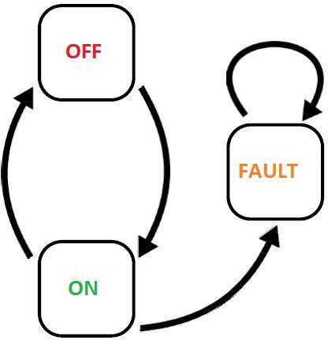
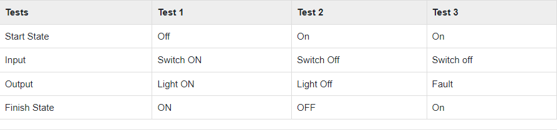
Black box testing techniques
State Transition Testing
Used in which outputs are triggered by changes to the input conditions.
Designed to execute valid and invalid state transitions.
Ex:

Slide 30
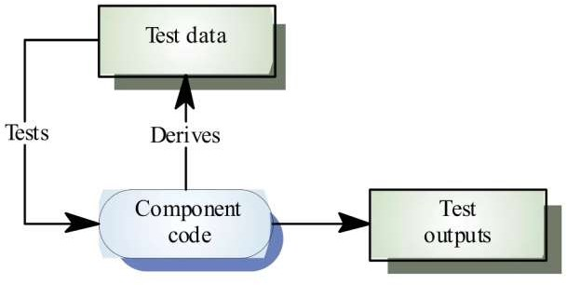
White box testing
Testing based on analysis of the internal structure of the component or system

Slide 31

White box testing techniques
The goal of White Box testing in software engineering is to verify all the decision
branches, loops, and statements in the code.
Statement Coverage:
we would only need one test case to check all the lines of the code.
If I consider TestCase_01 to be (A=40 and B=70), then all the lines of code will be executed.
INPUT A & B C = A + B
IF C>100 PRINT “ITS DONE”

Slide 32

White box testing techniques
Branch Coverage:
which will evaluate the “FALSE” conditions.
Branch coverage to ensure maximum coverage.
TestCase_01: A=33, B=45
TestCase_02: A=25, B=30
INPUT A & B C = A + B
IF C>100 PRINT “ITS DONE”
Else
print “Its Pending”

Slide 33

White box testing techniques
Path Coverage:
used to test the complex code snippets.
which basically involve loop statements or combination of loops and decision statements.
INPUT A & B C = A + B
IF C>100
To ensure maximum coverage, we would require 4 test cases.
PRINT “ITS DONE” END IF
IF A>50 PRINT “ITS PENDING” END IF

Slide 34
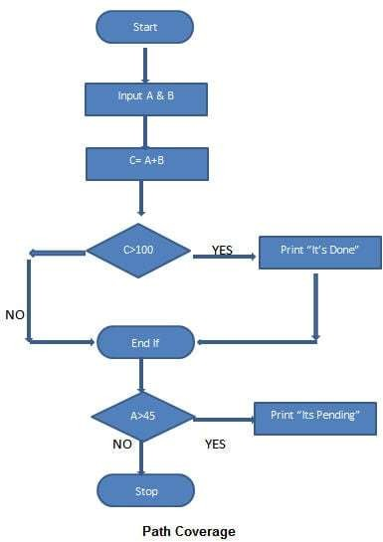
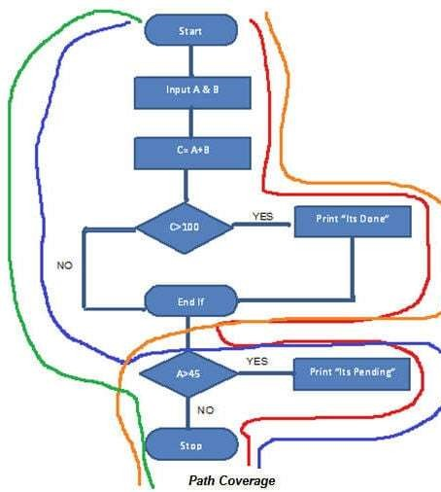

TestCase_01: A=50, B=60 TestCase_02: A=55, B=40 TestCase_03: A=40, B=65 TestCase_04: A=30, B=30

Slide 35
Test cases objectives
Test to pass(Happy scenario)
Assures that the software minimally works
Applies simple and straightforward test cases
Test to fail(Bad scenario)
Choose test cases to appear the weaknesses in software
Designing test cases with the sole purpose of breaking the software

Slide 36
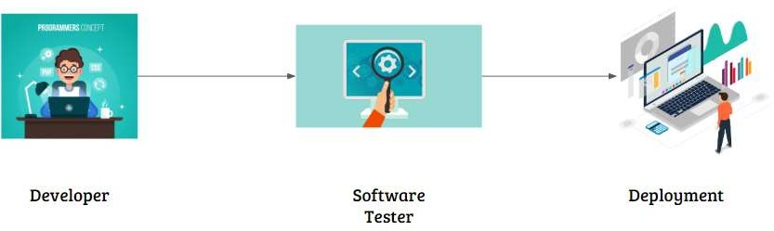
Software Deployment Cycle

Slide 37
SDLC and STLC
SDLC: SDLC is Software Development Life Cycle. It is the sequence of activities carried out by Developers to design and develop high-quality software.
STLC: STLC is Software Testing Life Cycle. It consists of a series of activities carried out by Testers methodologically to test your software product.

Slide 38
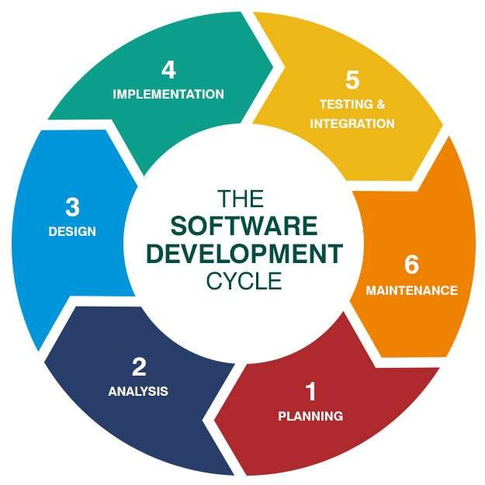
SDLC

Slide 39
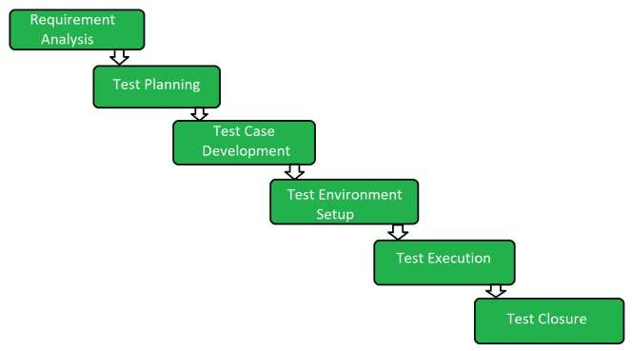
STLC Life Cycle

Slide 40
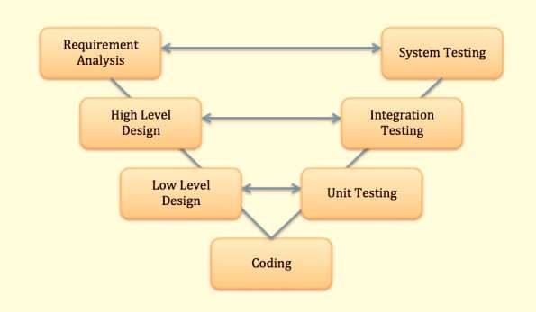
V Model

Slide 41


Thanks

